Slide 1
Let’s Wake Up Your EF
YOUR TASK: Plan the optimal weekend
Lots of studying
Contact with people you care about
Move your body
Healthy eating plan
One fulfilling experience
Make a Calendar Plan for Friday evening through Sunday evening
After you make the optimal plan, note what would change if your computer crashed on Saturday morning.

Slide 2
Lecture Map
Theory
Clinical Model (Sohlberg & Mateer)
Neuroanatomical model (Stuss)
Cognitive processing models (Shallice/contention scheduling & Kennedy-self monitoring)
Assessment (BRIEF, DKEFS, BADS, COWAT)
Intervention
Range of interventions
GMT
Training External aids

Slide 3
Executive functions
Umbrella term to describe those abilities that are required to complete goal directed activity that is not overlearned, automatic or routine
“Higher order” executive functions are distinguished from lower cognitive functions (sensory processes, knowledge and skills, basic information processing)

Slide 4
Executive Functions Symptoms
(Feeney, 2005)
impulsiveness
poor social judgment
social disinhibition
Egocentrism
difficulty interpreting the behavior of others
Perseveration
poorly regulated attention
disorganization (in thinking, talking, and acting)
weak goal formulation
ineffective planning
decreased flexibility/ shifting
slowed processing
diminished divergent thinking
concrete thinking
immature problem solving
weak self-monitoring
inefficient responses to feedback/ consequences
reduced initiation
dulled emotional responses

Slide 5
Damage to executive function system
Dysexecutive syndrome (DES)
Broad range of disturbed behavior such as impulsivity, distractibility, apathy, problems learning new tasks and behaving appropriately in social situations
Patients with impaired EF
May present with preserved cognitive functions, but fail to use them
Have difficulty when there is not sufficient structure to help them with task completion and task monitoring

Slide 6
Clinical Model of Executive Functions (Sohlberg & Mateer 2005)
Initiation & Drive: Starting behavior
Response inhibition: Stopping behavior
Task persistence: Maintaining behavior
Organization: Sequencing & Timing behavior
Generative thinking: Creativity, fluency, problem solving skills
Awareness: Self evaluation & insight

Slide 7
What does Dysexecutive Syndrome Look Like?
EF Domain
Initiation & drive
Applied to Communication Disorder
Does not initiate conversation
Applied to shopping
Does not go shopping even when fridge empty
?
Response inhibition
Task persistence
Organization
Generative thinking
Awareness
Inappropriate comments
Poor topic maintenance
Poor verbal organization
Little to say; trouble with open-ended ?s
Does not seem to notice if others are not interested in topic
?
?

Slide 8
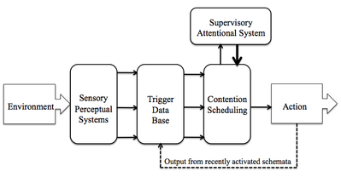
Cognitive Processing Model: Shallice Model
Contention scheduling: routine control (habitual schemes)
Supervisory attention system: override contention scheduling; required for novel situations
Types of situations requiring more than routine activation of behavior are ones that
require planning/decision making
depend upon error correction
Require novel responses
are dangerous or technical
Require resisting temptation

Slide 9
Comparing EF models
Stamenova & Levine (2018) describe a model of EF upon which GMT is based. How does it compare to the Sohlberg & Mateer clinical model and the Shallice model?

Slide 10
Theoretical Model: self-regulation (Kennedy & Coelho, 2005)
Self-monitoring is the ongoing self assessment that occurs internally during cognitive-communicative activities.
Compares actual performance with an expected performance creating internal feedback that is used to make a decision about a strategy or action
Self-regulation involves changing behavior in response to self monitoring

Slide 11
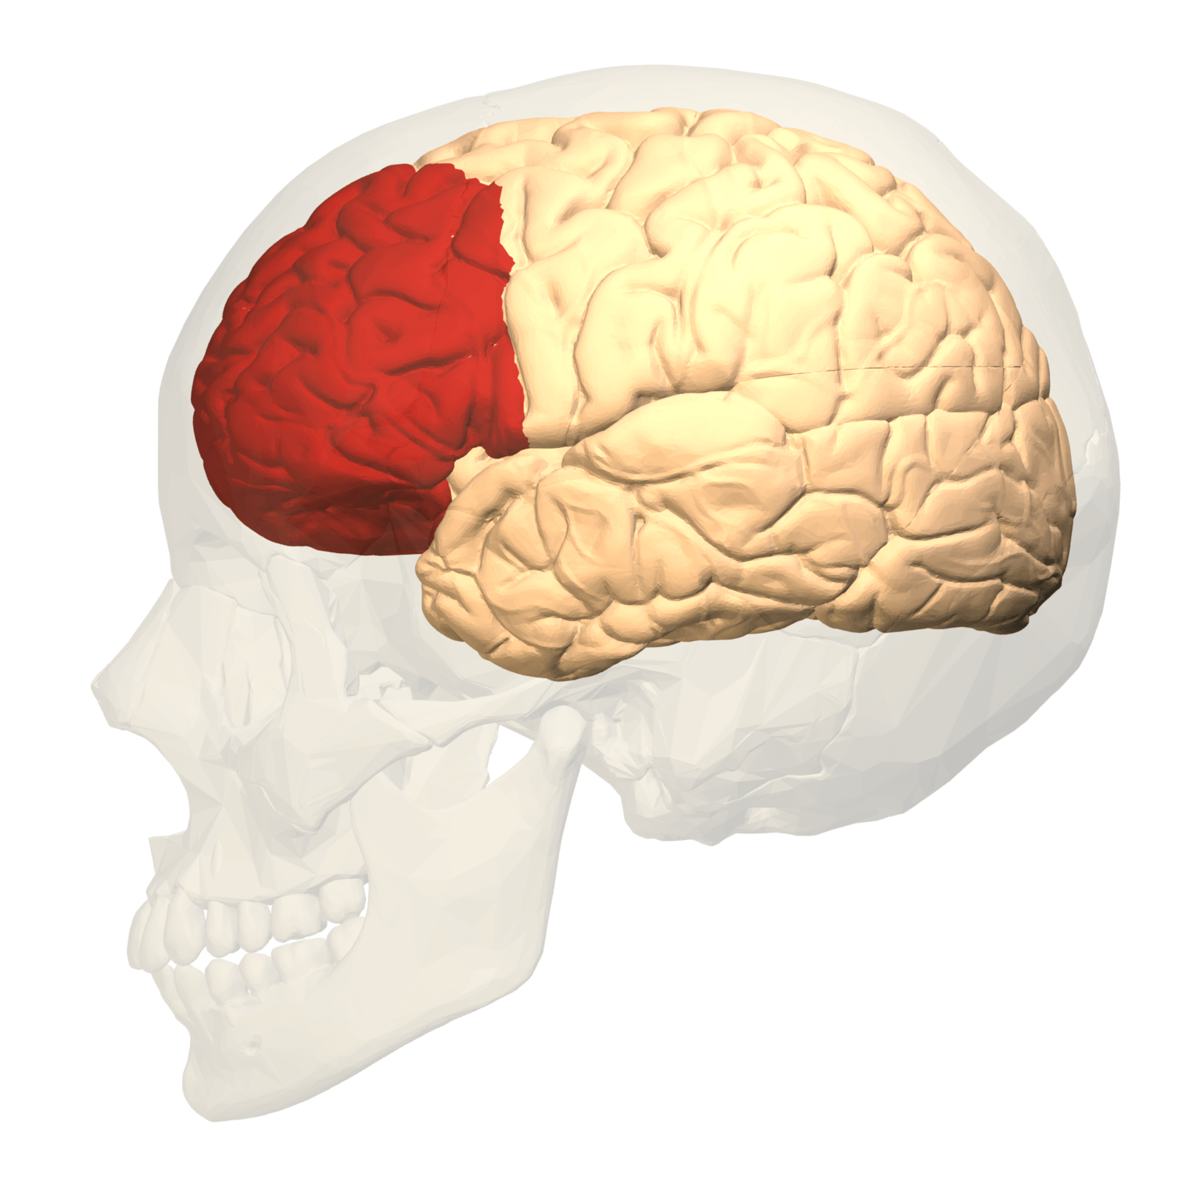

Slide 12
FOUR DOMAINS OF FRONTAL LOBE FUNCTIONING: Neural Correlates (Donald Stuss)
Energization/regulation
-superior medial region
Executive/cognitive
dorsolateral medial
Behavioral Self-regulatory
orbital/ventromedial
Metacognitive-Self awareness
Frontal poles
Primarily right

Slide 16

Translating neurology into behavior (Stuss)
Energisation – doing
Executive cognitive – thinking
Emotional and behavioural self-regulation –feeling and acting
Metacognition – awareness and socialising
© The Oliver Zangwill Centre 2012
16

Slide 17
Energisation – doing
“She seems to be lazy now, lacking any motivation. She needs to be made to do things”
© The Oliver Zangwill Centre 2012
17

Slide 18
Executive cognitive – thinking
“ Since the injury, my wife sees things from day to day and finds it very hard to plan ahead. We tried to plan a holiday together with the children, but she couldn’t make decisions about where to go or when to go. In the end, I did all the planning and organising.”
© The Oliver Zangwill Centre 2012
18

Slide 19
Emotional and behavioural self-regulation –feeling and acting
“He says and does things that are quite rude, and very out of character for him….he says or does things without thinking”
© The Oliver Zangwill Centre 2012
19

Slide 20

Metacognition – awareness and socialising
“He is a completely different person now and he doesn’t even know it.”
20

Slide 21
Clinical Model of Executive Functions (Sohlberg & Mateer 2005)
Initiation & Drive: Starting behavior
Response inhibition: Stopping behavior
Task persistence: Maintaining behavior
Organization: Sequencing & Timing behavior
Generative thinking: Creativity, fluency, problem solving skills
Awareness: Self evaluation & insight

Slide 22
Laboratory EF Tasks Tied to Different Circuits
Flanker Task: Response Inhibition tests that assess ability to repress suppress responses that are not appropriate
In a certain context.
Go/No Go Task: Sustained attention and response control Task. Participant must perform under one condition
and suppress response under another condition.

Slide 23
Causes of Acquired EF Impairments
Brain injury
Stroke
Tumor
Post-anoxic encephalopathy
Neurodengenerative diseases associated with changes in fronto-subcortical structures (Parkinson’s, frontotemporal dementia, Alzheimer's)
NOTE: Researchers have not found systematic differences in EF deficits between patients with TBI, stroke or other neurological etiologies (Spikman et al., 2013)

Slide 24
Developmental Trajectories in EF (Diamond 2013)
Foundational EF components that emerge with different trajectories
Inhibition
Move from basic response inhibition to managing conflict response.
Large improvements during the preschool yrs to more modest change during adolescence
Working memory
Move to increasingly more complex ability to maintain and manipulate information
More of a linear projection from preschool through adolescence
Shifting
Ability to shift between mental states, rule sets or tasks (requires inhibition and WM)
Protracted development through adolescence
Metacognition may play an important role during school age/adolescence

Slide 25
What might DES look like in the classroom?
Difficulty with transitions
Talking out of turn
Difficulty managing assignments or homework
Difficulty managing materials
Difficulty with routines or multistep tasks
Unaware of impact of behavior on others
And…

Slide 26
Examples of classroom impact
Assignment management
Unable to recall assignments
Difficulty gathering/organizing materials
Difficulty starting and remaining engaged in work
In-class behavior regulation
Difficulty staying “on task”
Struggle to transition from one activity to another
Mathematics
Difficulty sequencing multi-step procedures
Reduced performance monitoring
Writing
Difficulty planning a narrative

Slide 27
Common misperceptions The child with DES…
is “lazy”(initiation disorder)
has an intellectual or learning impairment (may have preserved language/cognition & ef impairments get in the way)
is noncompliant (organization or awareness issues)

Slide 28
Developmental Overlay
Effects of brain injury in children are particularly profound because the injury occurs to a developing brain (Welsh & Pennington, 1988)
Recovery is superimposed on normal developmental processes, impacting previously learned skills and the development of future skills (Ewing-Cobbs et al., 1997)

Slide 29
Developmental Overlay
Full effects of an earlier injury may not be evident until adolescence when children are expected to demonstrate increasing competence in executive functions and reasoning.
Skills may not develop if the relevant areas of the brain have been damaged (Alden & Taylor, 1997; Feeney & Ylvisaker, 1995; Mangeot et al, 2002; Ylvisaker & Feeney, 2002)

Slide 30
Developmental Overlay
Children may also develop deficits in the social and behavioral domains secondary to these cognitive deficits.
For example, primary deficits in executive functions have implications for the child’s behavior in the classroom and peer relationships. Such secondary deficits may become more pronounced in a child injured at an earlier age.

Slide 31
https://www.youtube.com/watch?v=Wz1pnFBLZM4

Slide 32
Assessment of EF
Ecological validity of standardized testing for EF is questionable
Most standardized tests are structured and provide the client with well-defined cues on what is expected
The examiner takes over the role of EF
“Many patients succeed on EF tests but fail at life”
In real life, when structure is lacking, actions/activities that require EF have to be self imposed
What constitutes “normal” or “typical”
What does Spikeman article say about standardized testing of EF?

Slide 33
Assessment
Observational methods
Executive Function Route Finding Test
Questionnaires
Behavioral Rating Inventory of Executive Function (Giola et al.)
Dysexecutive Questionnaire (DEX part of BADS)
Standardized impairment-based measures-Batteries:
Behavioral Assessment of Dysexecutive Syndrome (BADS)
Delis Kaplan Executive Function System (DKEFS)
FAVRES (Functional Assessment of Verbal Reasoning and Executive Strategies
Targeted Tests
STROOP (inhibition)
WCST (problem solving)
Fluency (COWAT)

Slide 34
BRIEF
Questionnaire assessment of 86 executive function behaviors at home/school/community (children and adult version)
Separate forms for informant reporting (e.g., parent, teacher, sig o.)
Different scales:
Behavioral regulation scales
Inhibit
Shift
Emotional control
Metacognition Scales
Initiate
Working Memory
Plan/Organize
Takes about 20 minutes to administer

Slide 35
Behavioral Assessment of Dysexecutive Syndrome
Video Example of the BADS
https://www.youtube.com/watch?v=A2mhDxfhMlA

Slide 36
FAVRES
Getting the Facts – Can the person identify the most important facts?
Eliminating Irrelevant Information – Can the person identify and ignore less relevant information in order to focus on more important information?
Weighing the Facts – Can the person compare or weigh competing options or criteria?
Flexibility – Can the person revise a decision or plan of action when presented with new information?
Generating of Alternatives – Can the person efficiently generate a variety of solutions, options or alternatives?
Predicting Consequences – Can the person predict potential outcomes, pros and cons, or consequences of a choice?
Providing a Rationale – Can the person provide a rationale or a set of reasons for making a choice?
Subtests: Plan an Event; Schedule a Work Day; Decide on a Gift; Build a Case to Solve a Problem

Slide 37
Assessing EF in children
EF relatively immature in childhood; protracted process into early adolescence
behavioral observations and dynamic assessment important
Standardized tests (we have in clinic):
Test for Everyday Attention for Children(TEA-Ch)
Delis–Kaplan Executive Function System (D-KEFS).
Connor’s Performance Test: Sustained attention, impulsivity, working memory

Slide 38
D-KEFS
Assesses flexibility, inhibition, problem solving, planning, impulse control, concept formation, abstract thinking, and creativity in both verbal and spatial modalities.
Subtests include:
Sorting (problem solving, verbal and spatial concept formation, flexibility of thinking);
Trail Making (flexibility of thinking on a motor task)
Verbal Fluency
Design Fluency (fluent productivity in the spatial domain);
Color-word Interference (verbal inhibition);
Tower (planning and reasoning, impulsivity)

Slide 39
Treatment of Executive Functions
“Rehabilitation for executive disorders is broadly conceptualised as shifting the individual from a more dependent, externally supported state to a more independent and self-regulated state”
(Sohlberg & Mateer, 2001)

Slide 40
Treatment Approaches
Direct training of cognitive processes
Goal Management Training
Specific functional skills training
Cognitive strategy training
Metacognitive strategy training/Self instructional training/problem solving routines
Selection & training use of assistive technology
Environmental management/task accommodation
Personalized education and understanding

Slide 41
Environmental Management
Setting up the environment to take the load off the frontal lobes
Domain/task specific
Requires functional analysis…gather data first.
Be systematic and monitor impact

Slide 42
Focus on the environment vs. the individual
Acknowledges that people with DES cannot flexibly apply strategies in different contexts
Fostering appropriate environment will be more successful than individual remediation

Slide 43
Metacognitive Strategy Training
General Metacognitive Strategies: designed to address impairments in attention, executive functions and problem solving and memory
Task Specific Strategies: Designed to assist with completion of specific task or goal.
CHAPTER 8!

Slide 44
What is the Mechanism of Action Behavioral or Cognitive Processing
Teaching strategies
Teaching use of external aid
Exercises designed to improve specific EF (GMT)

Slide 45
GMT Theory From Your Reading
“The theoretical foundation of GMT holds that the sustained attention system maintains higher order goals in mind while inhibiting automatic processes (Robertson & Garavan, 2000). Executive deficits emerge from the disruption of this distributed system such that automatic processes prevail over higher order goals. GMT trains individuals to periodically stop ongoing behaviour to interrupt automatic processing, bring their overarching goal to mind, subdivide the overall goal into subgoals, and monitor performance. This is accomplished through psycho-educational instruction, narrative, within- and between- session exercises that illustrate concepts and principles. GMT incorporates mindfulness meditation (Segal, Williams, & Teasdale, 2002). Mindfulness meditation augments GMT by training the ability to bring attention to the present moment in order to monitor the relationship between current circumstances and higher order goals.”

Slide 46
Task Completion Strategies
Idea is that patients learn a series of steps that helps them attend to and regain control over their task execution
1. Stop: What Am I doing?
2. Define the main task
3. List the steps
4. Learn the steps
5. Do It
6. Check: Am I doing what I planned
Research suggests GMT more effective when embedded in multifacted treatment like the Spikman program—need problem solving training AND general planning approach

Slide 47
The importance of personalizing strategies
AIM (InfoCDS)

Slide 48
YOUR JOB
Understand the components of your intervention. Does the strategy promote:
Awareness
Self-monitoring
Self-regulation
Problem solving
Task completion
Some interventions promote all and some are focused just on specific skills or processes

